Slide 1
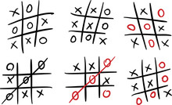
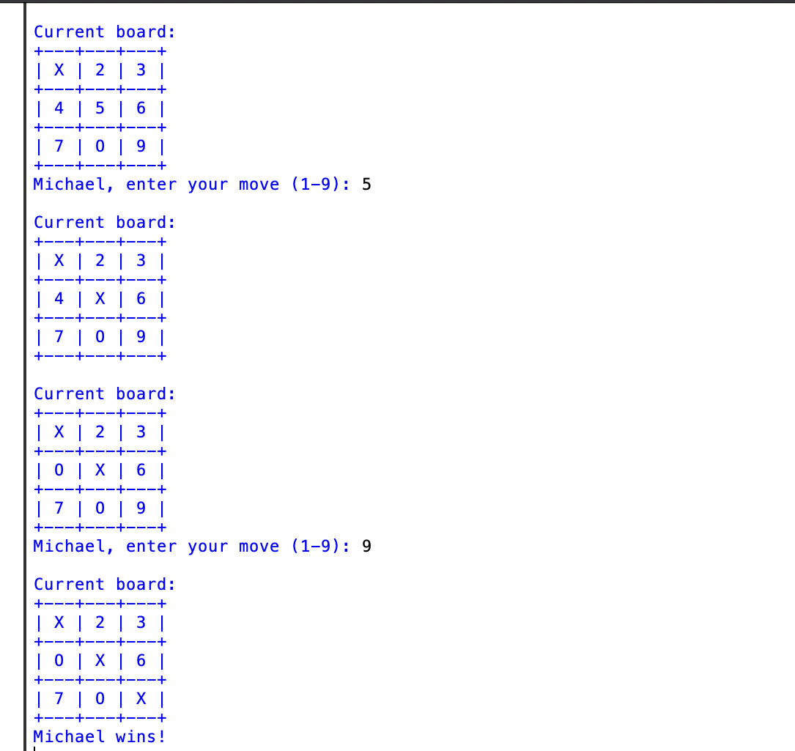
Tic-tac-toe Game
"Think you're unbeatable? Prove it on the grid. This Python-built Tic-Tac-Toe pits brains against brains in a no-luck, all-skill face-off!"
By: Michael James
Overview: Tic Tac Toe Python Game is a classic game where players can face off against a smart AI or compete in a two-player match. Built with a simple and interactive design, it offers quick, strategic gameplay that's both fun and easy to pick up.
GitHub Repo URL: https://github.com/ksu-is/Tictactoe-game

